Slide 1
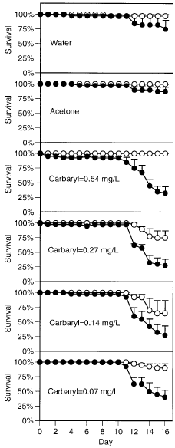
Figure 3:
Figure 3 describes various experimental environments for testing the effects of Carbayrl on tadpole populations.
Varied conditions of this experiment include test mediums consisting of water, acetone (control), and water with varying levels of Carbaryl.
Interesting features of this data include the time period in which survival rates decline within the 10 – 16 day period. Also the difference in relationships between survival rates with and without predators.

